Slide 1
Medical Data DeIdentification
deIDentiFiers

Slide 2
Problem
Medical data is sensitive and contains personally identifiable information (PII) that needs to be protected.
Researchers need access to medical data to gain valuable insights and learnings.
How can we provide access to deidentified medical data to researchers while protecting patient privacy?

Slide 3
Solution
Use generative AI techniques like NLP to remove PII identifiers from medical data and deidentify it.
Use natural language processing (NLP) and text vector embeddings to perform anonymisation tasks.
Use machine learning to train the model on large datasets of medical data and PII identifiers.
Input data can be either textual reports data like pathology tests, EMR or pictographic test reports like X-Rays, MRI, etc.
Build a secure platform where researchers can access the deidentified medical data for research purposes.

Slide 4
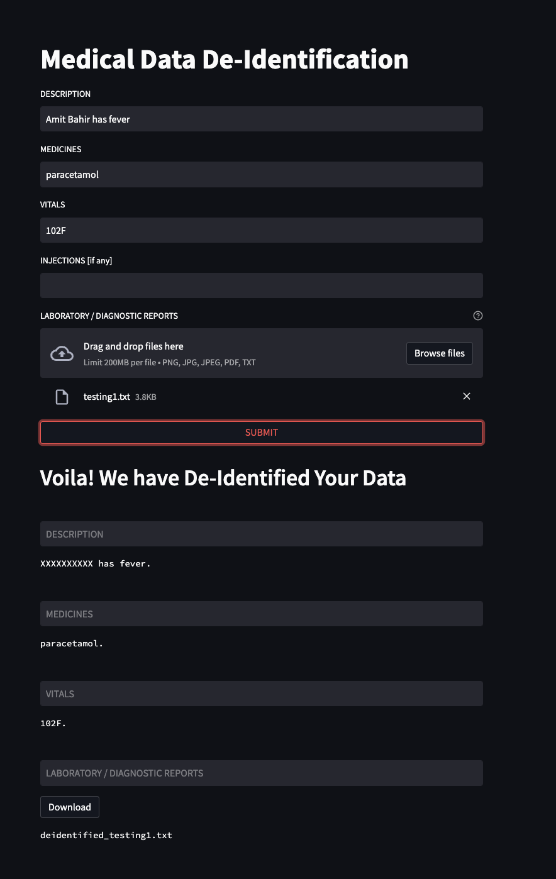
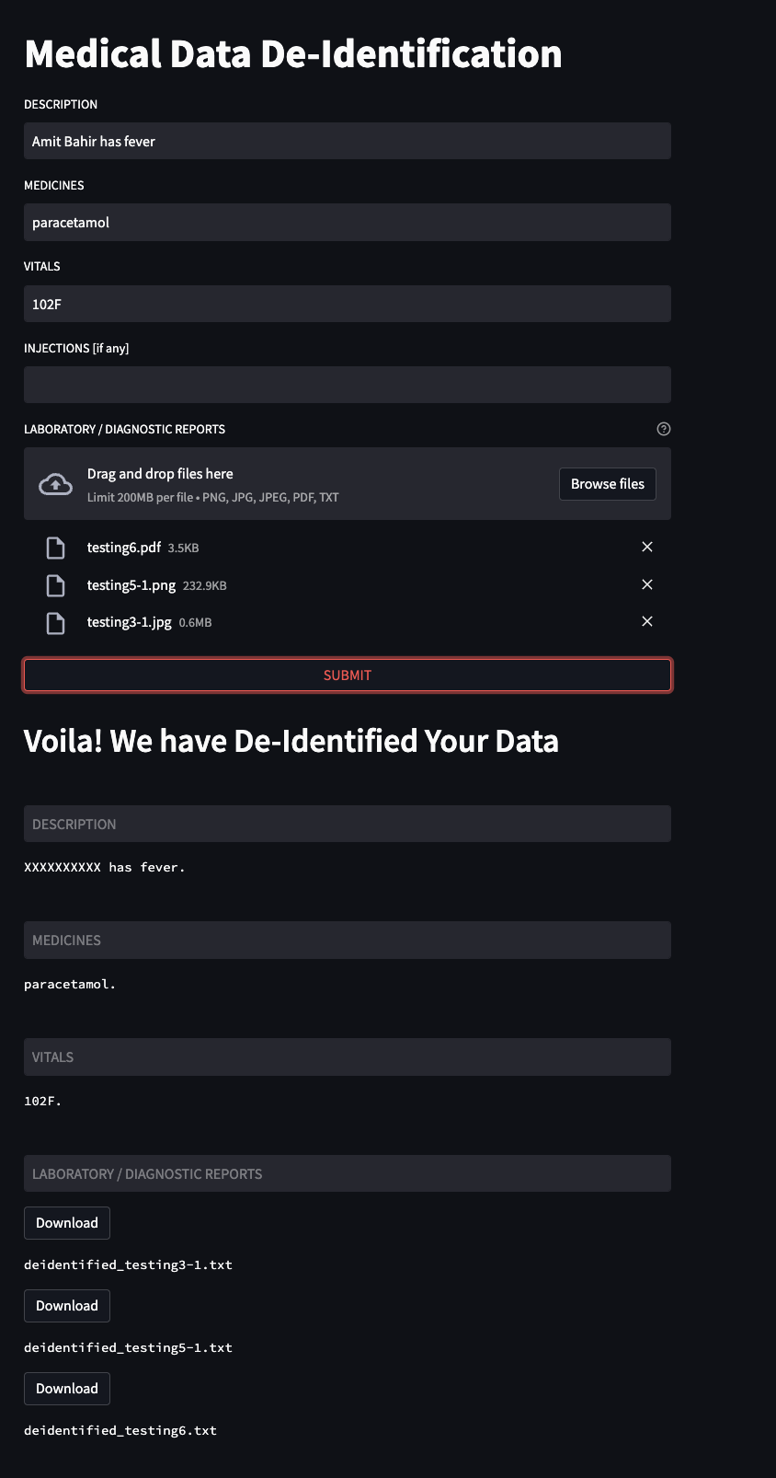

Slide 5
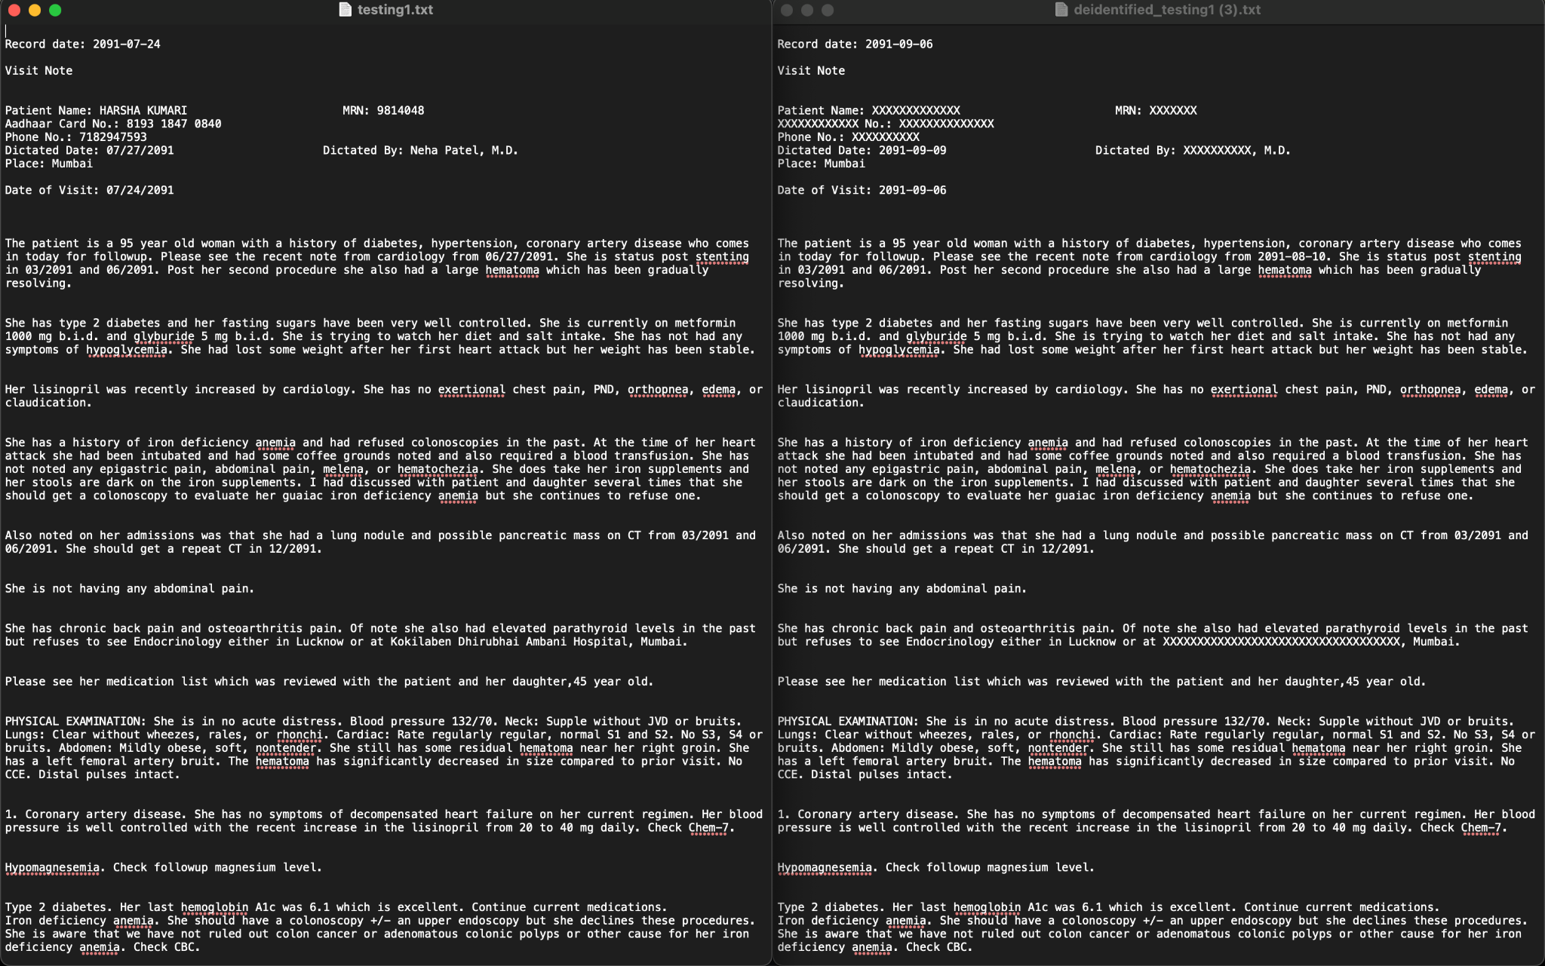

Slide 6
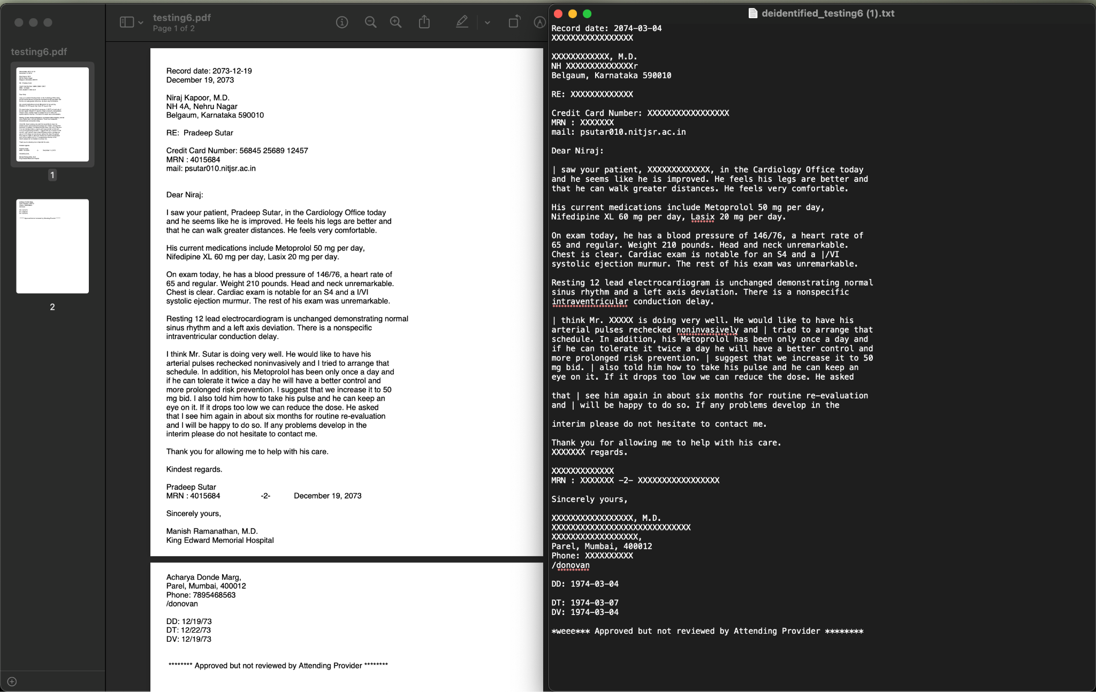

Slide 7
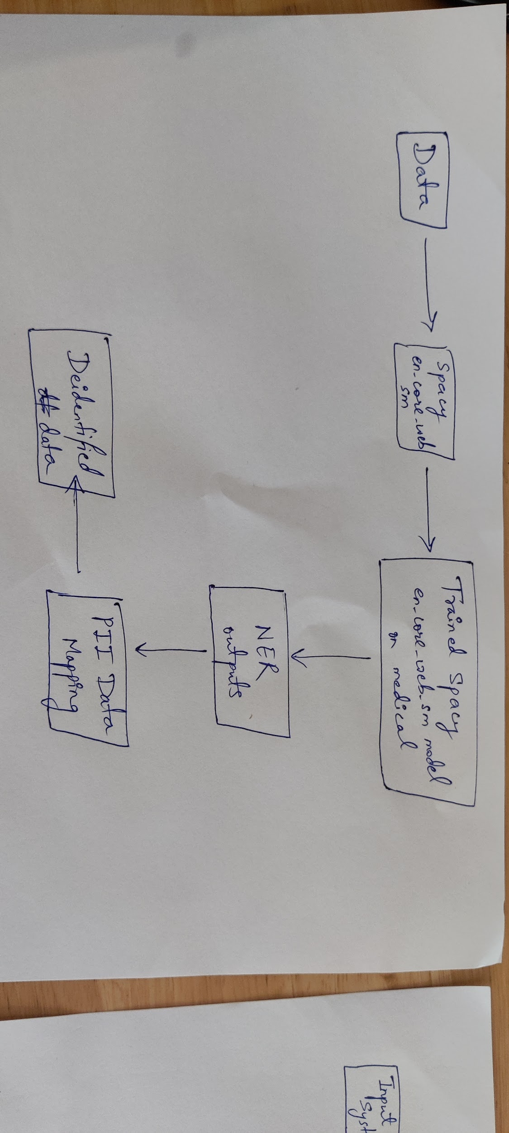
Technical Architecture

Slide 8
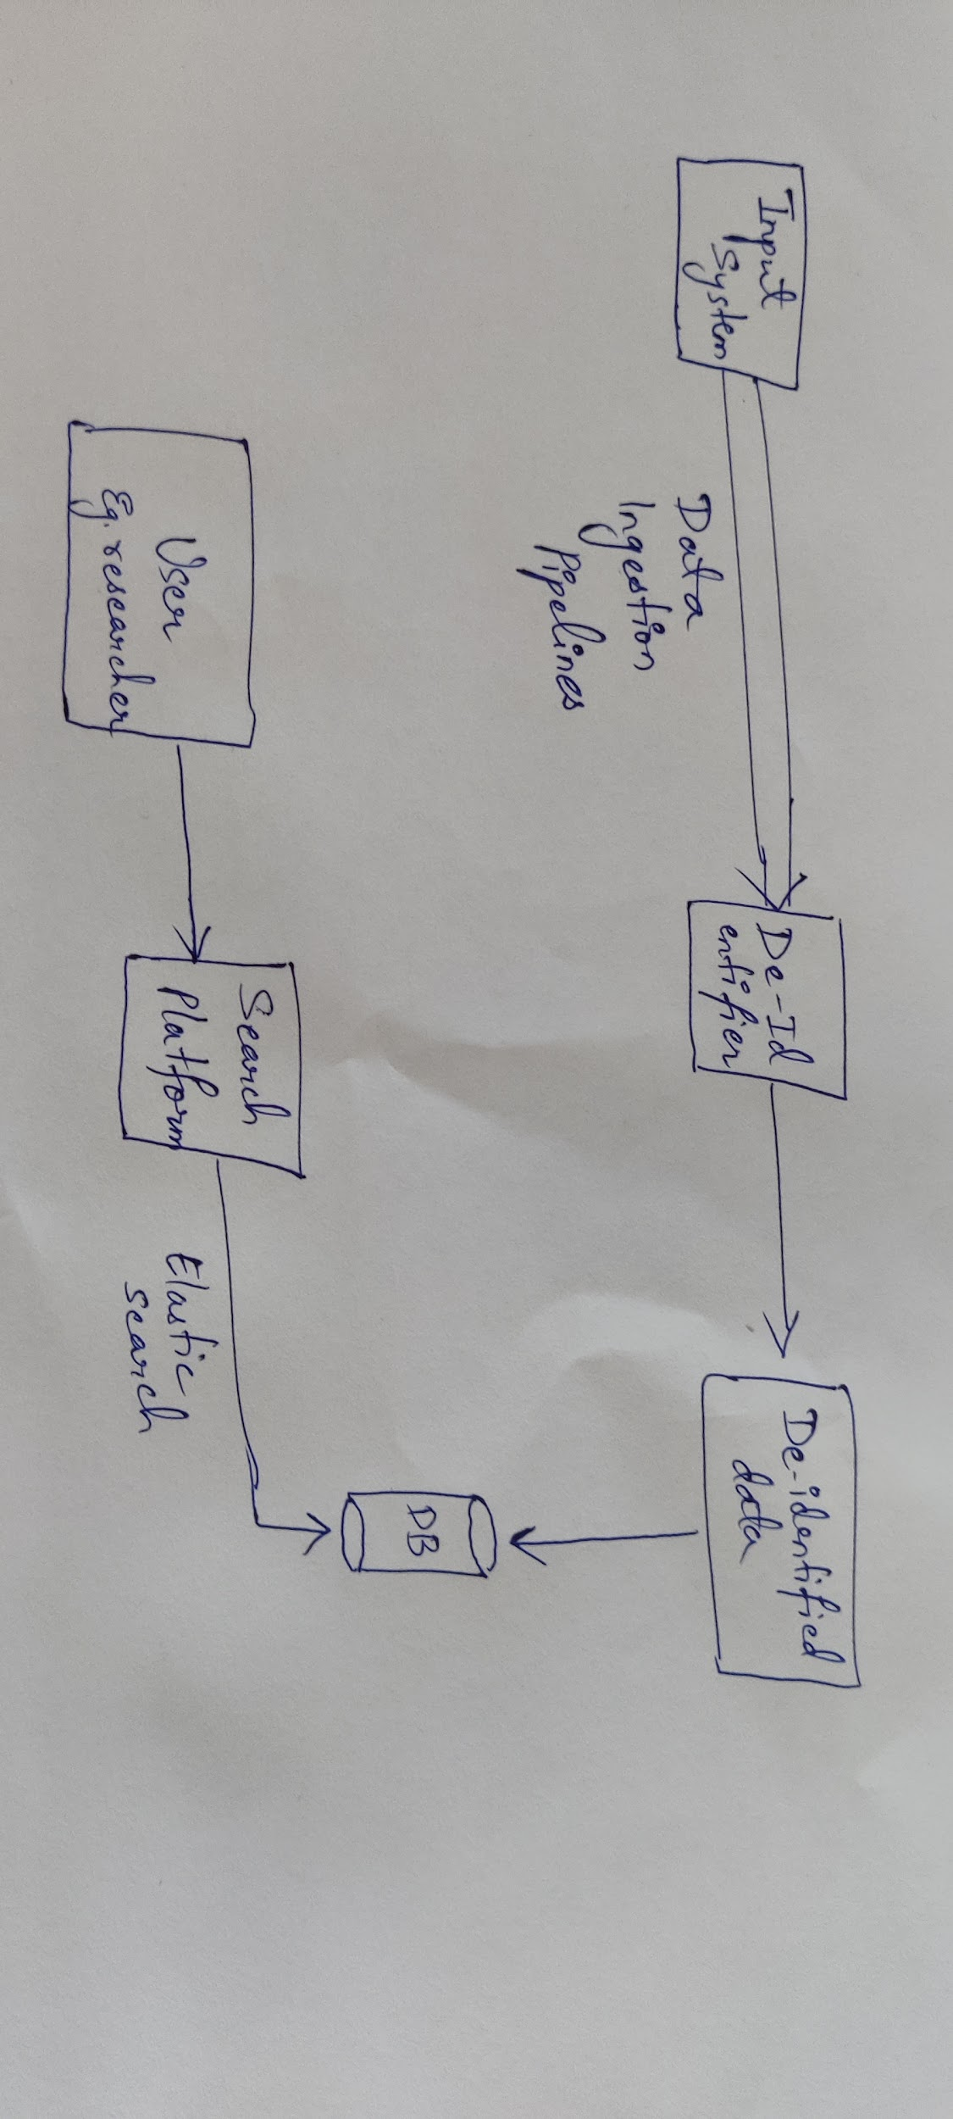
Platform Technical Architecture

Slide 9
Future Work
Integration with Partners via Data Ingestion Pipelines to ensure secured, streamlined input data.
Training model on a larger data set
Supporting Pictographic diagnostic tests like X-Ray, MRI, etc as input
Become HIPPA Complaint

Slide 10
Thank You!
Medical Data De-Identification | deIDentiFiers

